Slide 1
Technical Arts (TA 101AA)
Engineering Graphics
Prof. Nachiketa Tiwari
Department of Design

Slide 2
Isometric Projections
Part-II

Slide 3
Example: Box Method

Slide 4
Example: Box Method

Slide 5
Example: Without Box

Slide 6
Another Example
40
10
30
45
20
40

Slide 7
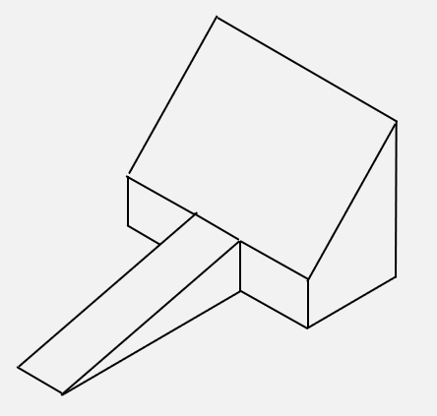
Another Example
40
10
30
45
20
40

Slide 8
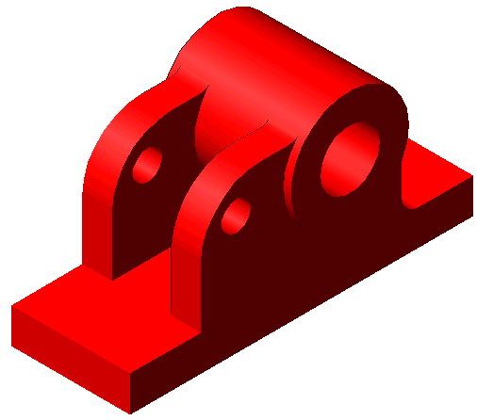
Circles
Circles appear as ellipses when drawn in an isometric sketch.
Center of any arc lies on a line perpendicular to the tangent from the point of tangency.
Four Center Method or Box Method may be used to draw isometric views of circles.

Slide 9
Circles in Isometric View
Orthographic View
Isometric View

Slide 10
Circles in Isometric View
Ellipse by four center method
Orthographic View
Isometric View

Slide 11
Isometric View of a Cylinder

Slide 12
Curves in Isometric Views
Circular or other curves will not show in its true shape when drawn in isometric views.
Any curve can be drawn by plotting points on it from isometric reference lines (co-ordinates) that are parallel to isometric axes

Slide 13
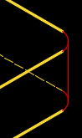

Arcs

Slide 14
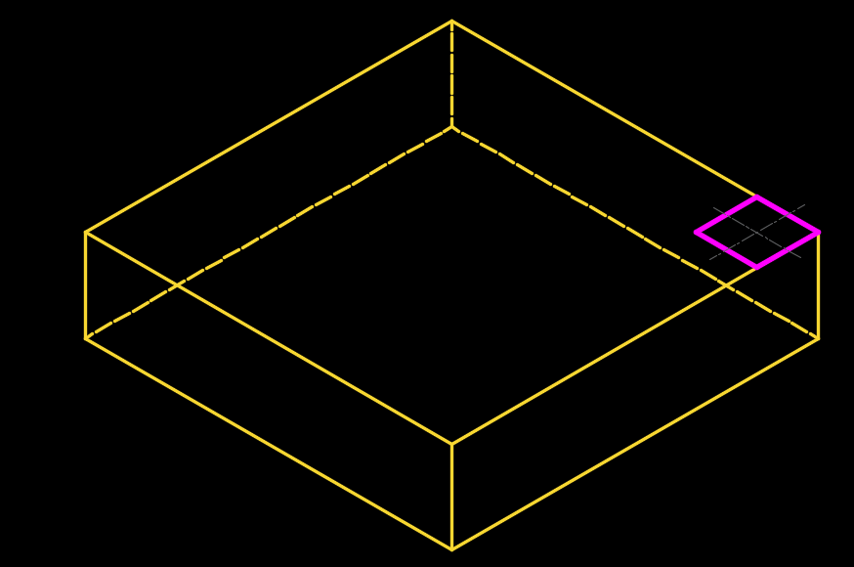
Arcs
Step 1: Determine the appropriate plane.

Slide 15
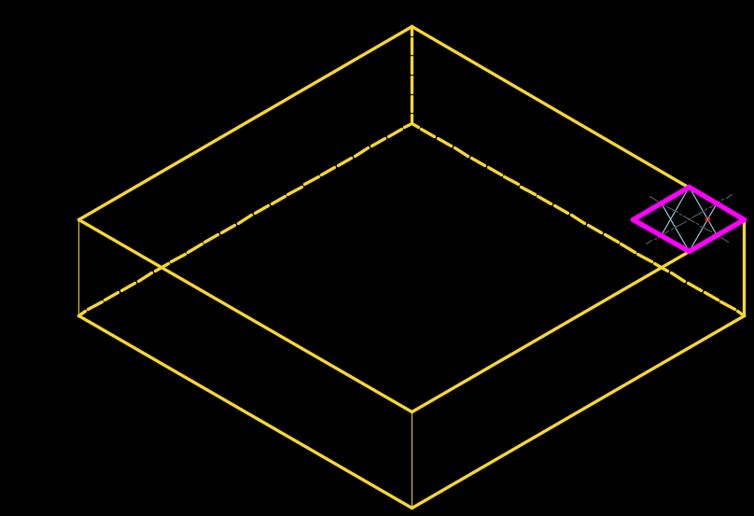
Arcs
Step 1: Determine the appropriate plane.
Step 2: Locate the centre of arc.

Slide 16
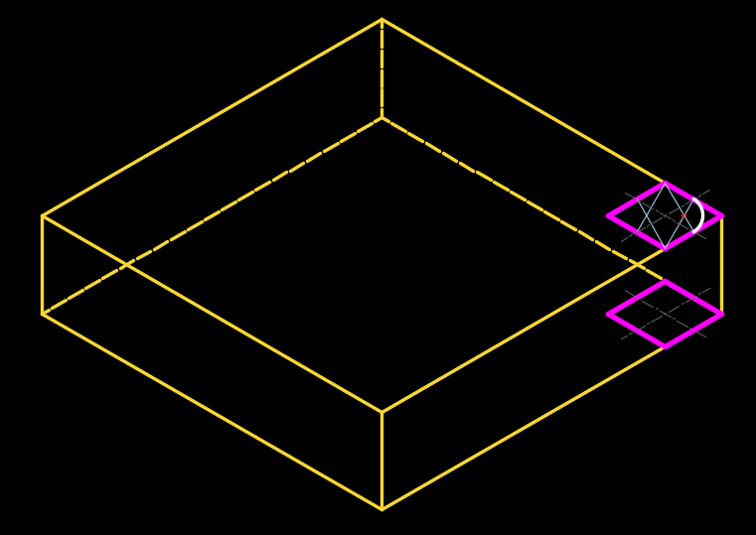
Arcs
Step 1: Determine the appropriate plane.
Step 2: Locate the centre of arc
Step 3: Draw elliptical arc.

Slide 17
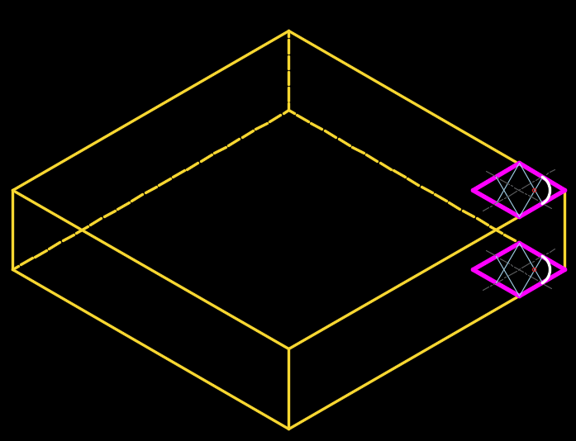

Slide 18
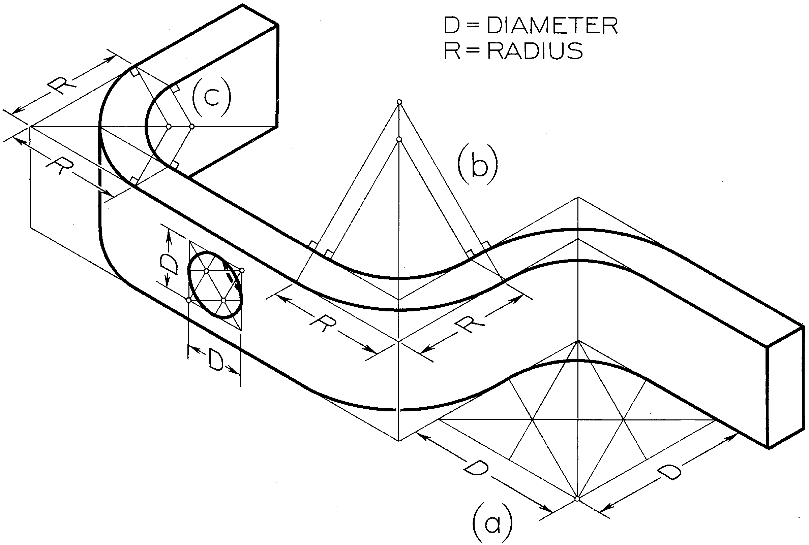
Arcs in Isometric Sketches
Arcs are usually sketched by:
  Locating their centers
  Boxing the arc in the enclosing parallelogram, which is drawn along isometric lines.
  Sketch the arc tangent to the enclosing box.

Slide 19

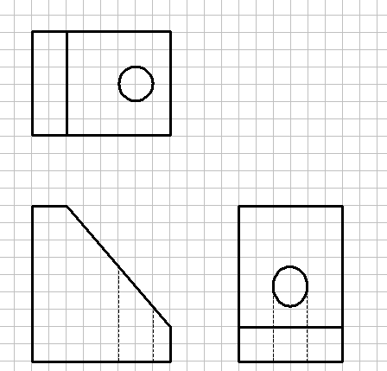
Circle on a Non-isometric Plane
Locate the center of the circle.
Point 1 coordinates? 2, 4, 3
1
1
1

Slide 20

Circle on a Non-isometric Plane
Locate the center of the circle.
Locate the ends of conjugate diameters and use the parallelogram method to construct the ellipse in isometric view.
1
1
1
1

Slide 21
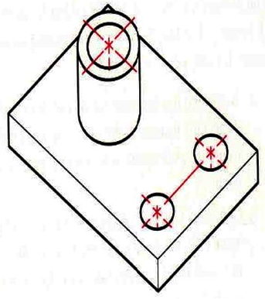
Center Lines
Drawn only for showing symmetry or dimensioning.
Often not shown when communicating with non-technical people and for non-engineering purposes.

Slide 22
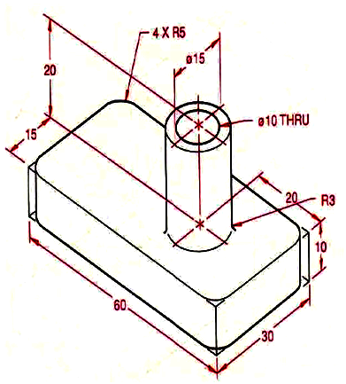
Dimension Lines
Dimension lines, extension lines and lines being dimensioned should lie in the same isometric plane.
All dimensions and notes to be located outside the view whenever possible.

Slide 23
Angles
Angles must be laid off with coordinates which are parallel to isometric axes.
  Convert angles of orthographic projection to coordinates at same scale as of Isometric.
60⁰
b
a
b
a
c
30⁰
60⁰
90⁰
90⁰
120⁰
120⁰
c
90⁰
60⁰

Slide 24
Offset Method
Used for objects with no well-defined isometric planes, i.e. neither non-isometric lines or their ends lie in isometric planes.
Perpendiculars are dropped from each end of the edge to horizontal or vertical reference plane (isometric planes).
The point of intersections are located to trace the actual location.

Slide 25
Example: Pentagonal Pyramid

Slide 26
Truncated Triangular Pyramid
d
d
x
q
x
q

Slide 27
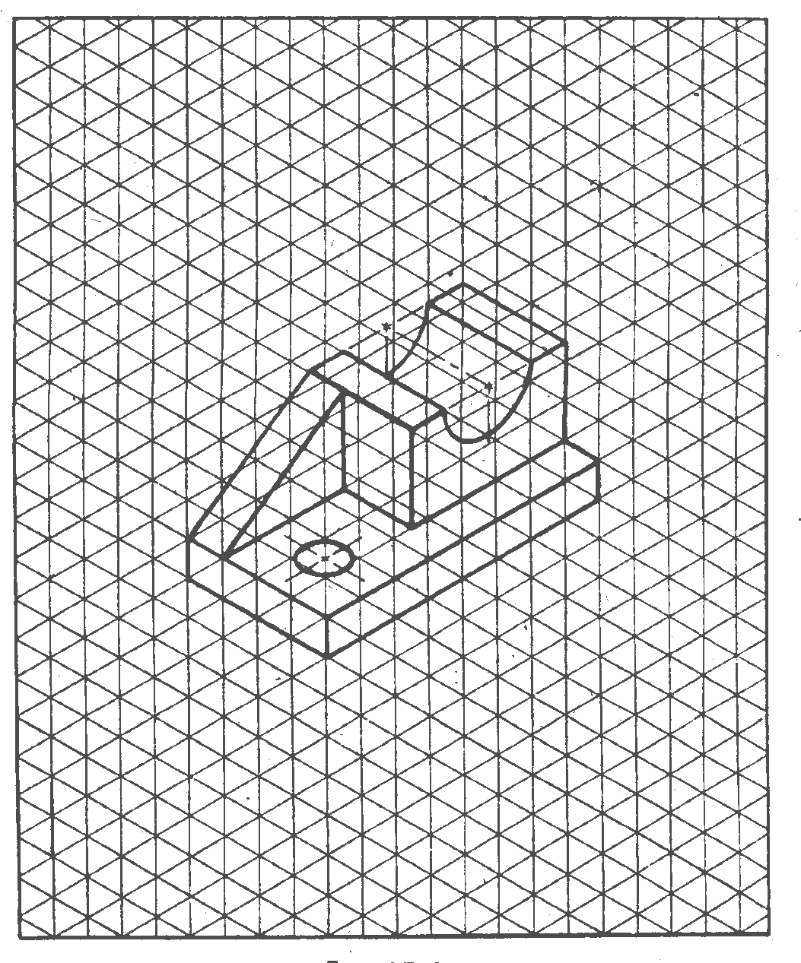
Use of Grid Sheets

Slide 28
Oblique Projections

Slide 29
Oblique Projection
Plane of projection is parallel to one of the principal planes of the object.
Projection lines are parallel, but NOT perpendicular to the plane of projection.
Object not tilted as done in isometric projection.
Distances 1-2, 1-3 do not change due to projection.
However, distance 1-4 can change.
Plane of projection
2
1
4
3

Slide 30
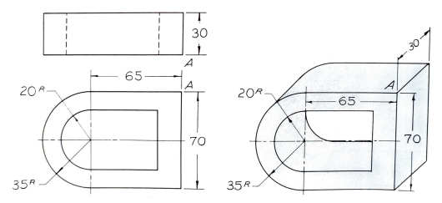
Oblique Projection
Features in the frontal plane (circles, etc.) do not get distorted.
Distortion limited to 3rd dimension.
Two types of oblique projections: Cavalier, Cabinet.

Slide 31
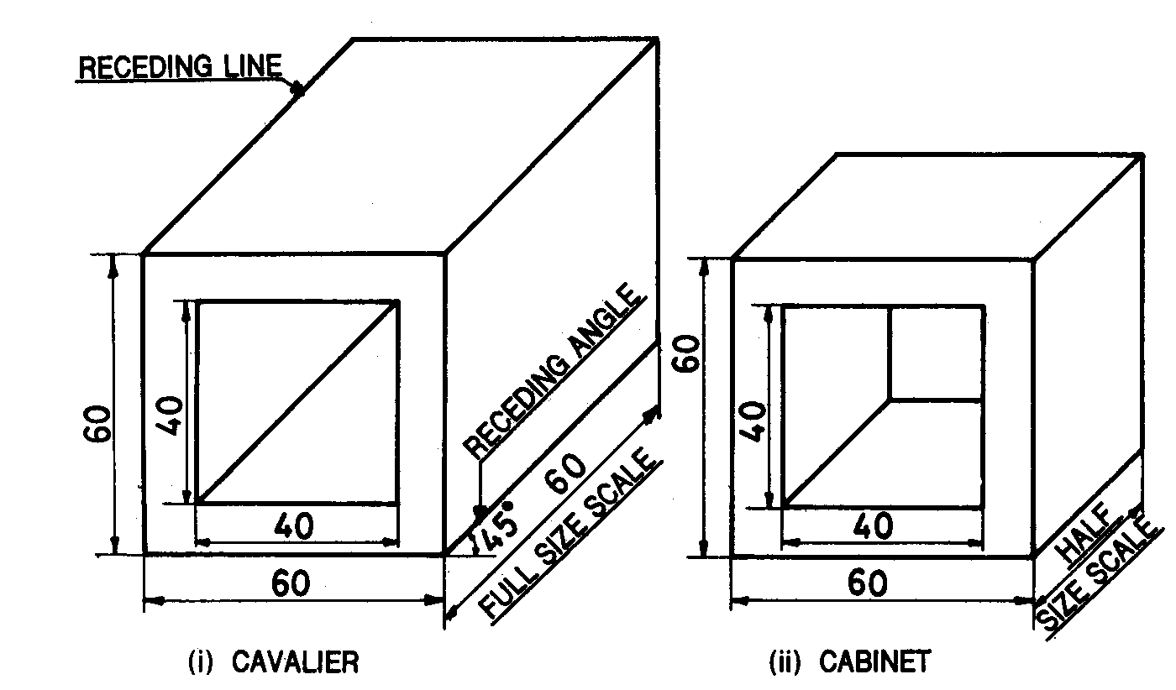
More About Oblique Projections
Two axes (width, and height) are mutually perpendicular.
Third axis (depth) is usually at 30º or 45º from the horizontal.
Width and height dimensions are at 1:1 scale.
Depth ratio: 1:1 for Cavalier and 1:2 for Cabinet.

Slide 32
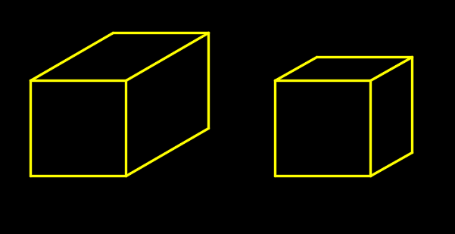
Which Object Looks More Like a Cube?
Depth dimension appears more than what it actually is.

Slide 33
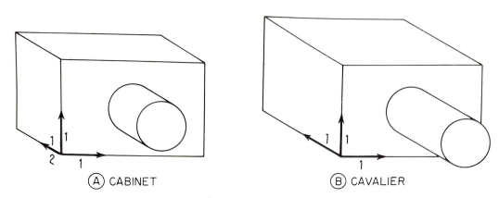
Cabinet and Cavalier Views

Slide 34
Isometric versus Oblique Projections
Isometric
Projectors are perpendicular to plane of projection.
Angle between three axes is equal.
Depth is 81% of actual.
Shapes will be distorted.
Oblique
Projectors are oblique to the plane of projection.
Two axes are mutually orthogonal. The depth axis is at 30º or 45º to the horizontal.
Depth is 100% in Cavalier and 50% in Cabinet of the original.
Shapes are not distorted in the plane parallel to object-face.

Slide 35
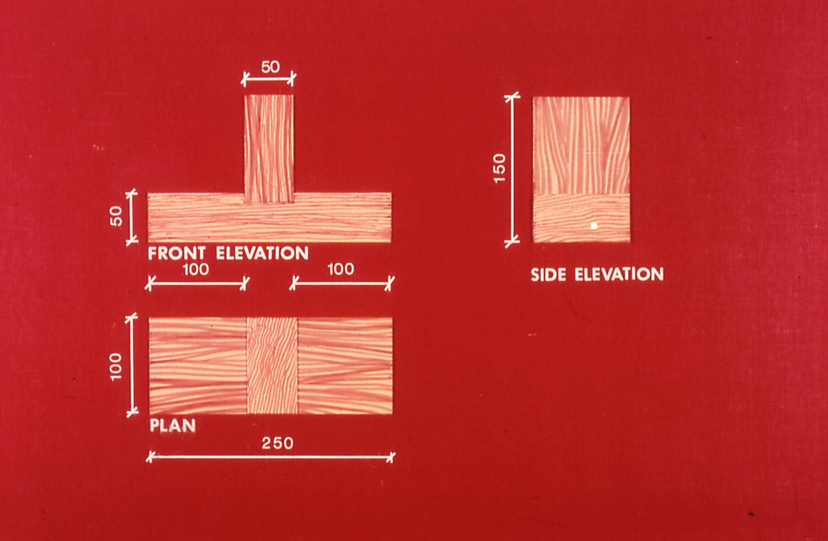
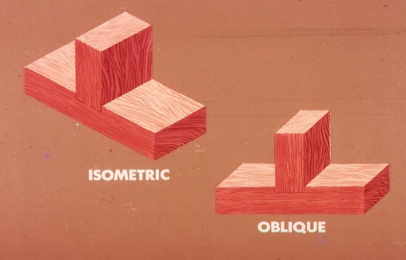
Orthogonal-Isometric-Oblique Projections

Slide 36
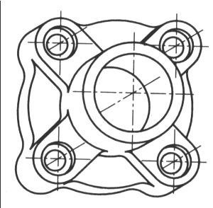
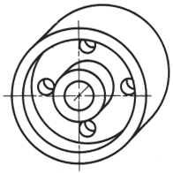
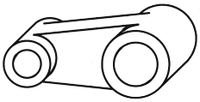
Object Orientation Guidelines
Place complex features (arc, hole, irregular shape surface parallel to frontal plane.

Slide 37
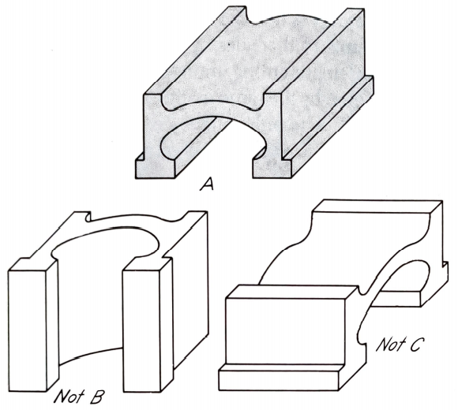
Correct Way of Placing an Object

Slide 38
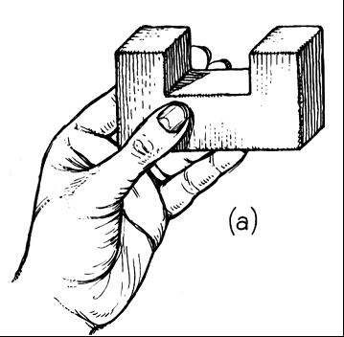
Sketching from an Actual Object
Estimate Depth
Estimate Lines
D
45°

Slide 39
Using Orthographic Projections
30⁰

Slide 40
Using Orthographic Projections

Slide 41
Step-by-Step Approach
Draw a rectangle: overall width and height of the object.
Generate parallel lines from each corner of the box backwards in depth direction at 30º or 45º to the horizontal.
Mark extension lines at points equaling the object’s depth.
Connect the depth-lines to form a box.
Add any details such as holes, notches, onto the front view
Extend the details in the depth direction of the object.
Complete the sketch by darkening in the object lines.

Slide 42
Example : Cavalier View
Φ20
40
30⁰
50
50
90
90
50
R15
15
40
CAVALIER VIEW
25
65

Slide 43
Example : Cavalier View
φ50
φ36
2 holes
φ20
φ30
10
80
10
40
200
8
20
100
CAVALIER VIEW

Slide 44
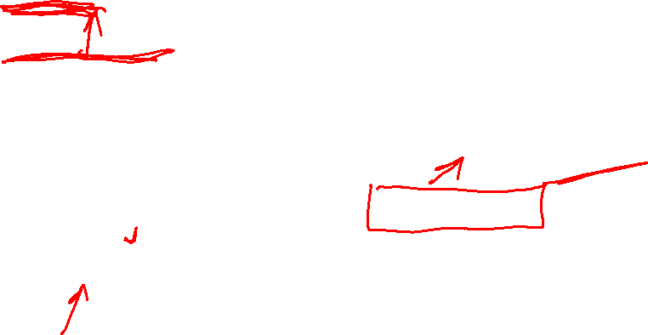
Example : Cavalier View

Slide 45
Example : Cavalier View

Slide 46
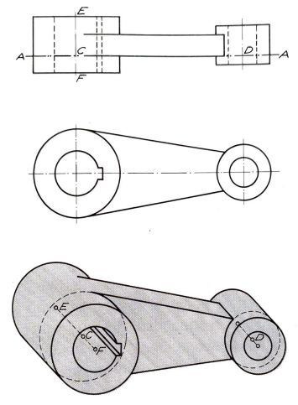

Exercise

Slide 47
Example : Cabinet View
φ 80
φ 60
φ 50
8
φ 35
Front
8
Top
50
30
8
4
40
8
20
130
20
25
CABINET VIEW

Slide 48
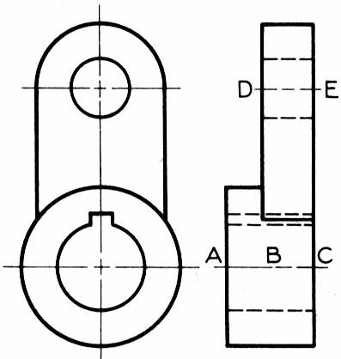
Example 6: Cavalier View
E
D
C
B
A

Slide 49
Example 6: Cavalier View
E
D
C
B
A

Slide 50
Example 6: Cavalier View
E
D
C
B
A

Slide 51
Example 6: Cavalier View
E
D
C
B
A

Slide 52


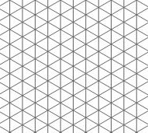
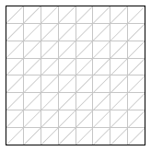
Grids for Different Projections
  Plain Cartesian grid
  Isometric grid Oblique grid

